Slide 1
INDIAN PREMIER LEAGUE 2008-2022
Overall team performance Analysis
BY abhijeet sethy

Slide 2
Summary
IPL (Indian Premier League) is a professional Twenty20 cricket league played annually in India. The league features teams representing different cities in India, and it follows a franchise-based model similar to other professional sports leagues
Keep in mind that this summary is based on historical information up until September 2022, and there might have been changes in recent seasons.
A few factors related to each team's performance are taken into consideration when doing the study. Because there are now fewer or more competing teams, the data analysis is based on the Kaagle dataset till 2022.

Slide 3

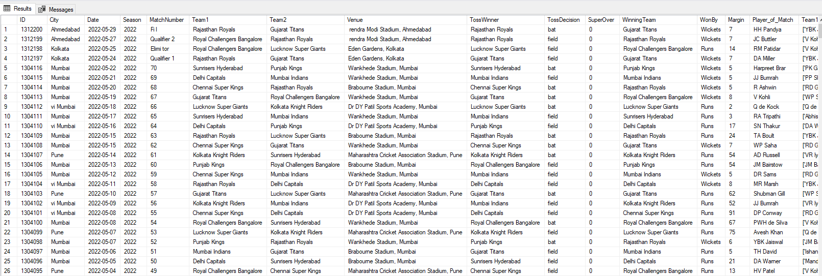
The Dataset.

Slide 4
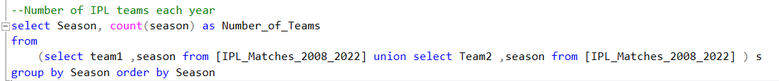
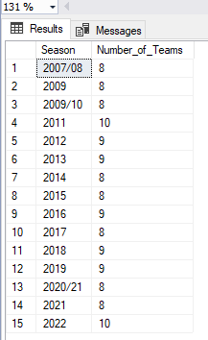
How many IPL teams have partaken each year ?

Slide 5

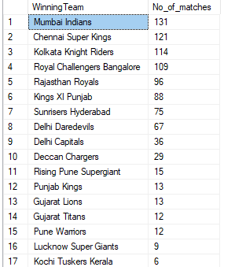
How many matches are won by each team through out 2008-2022?

Slide 6
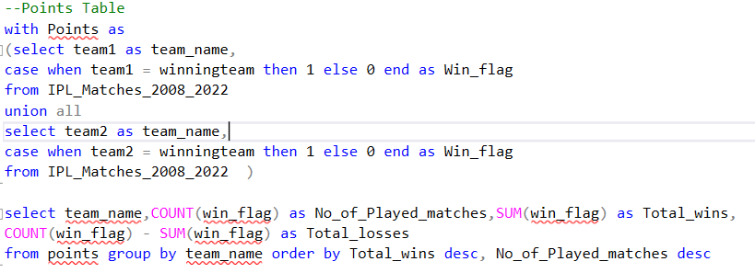
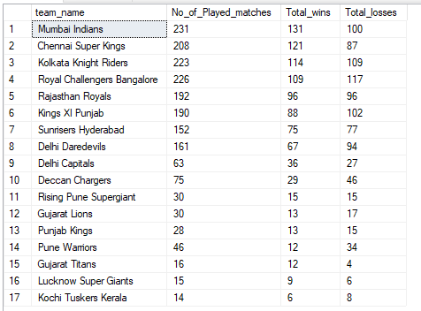
Generate a overall Points table for each team?

Slide 7
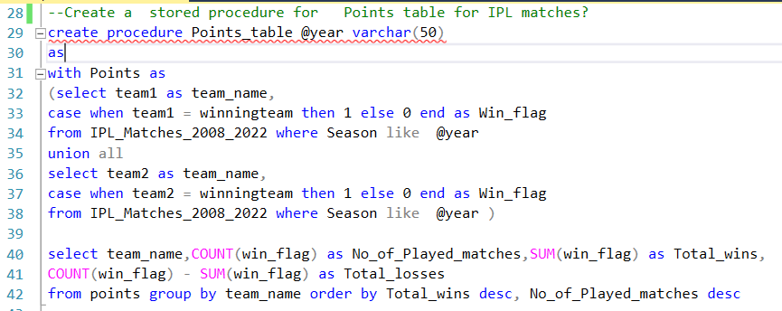

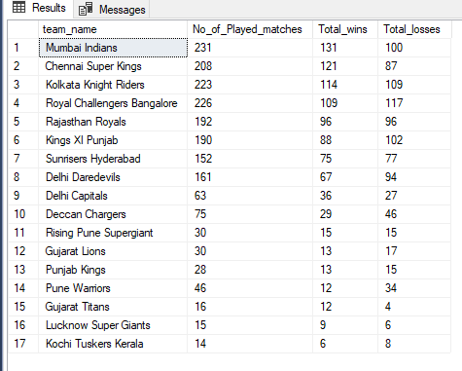
Create a Stored Procedure for Points table as per user required Year?

Slide 8
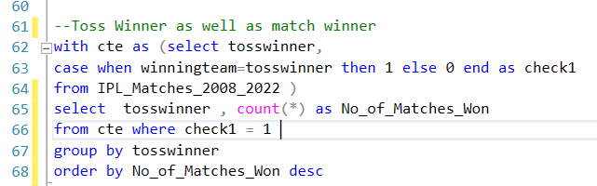
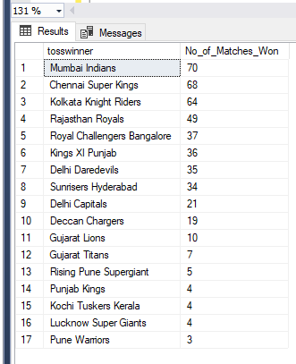
List the teams that have simultaneously won both the toss and the game?

Slide 9
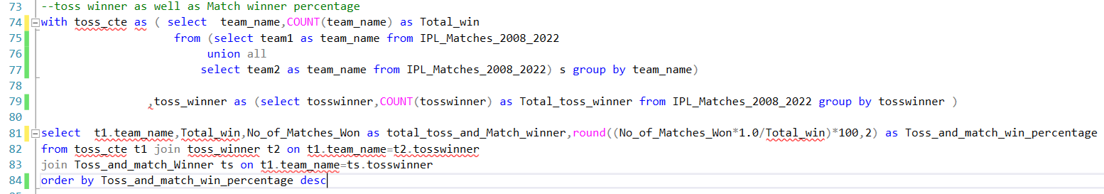
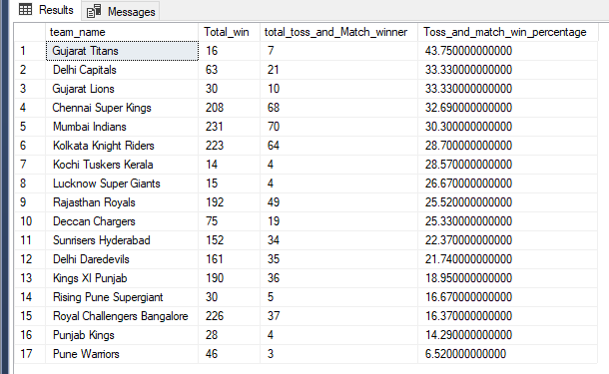
Percentage of Toss and match Winner with respect to Total Wins

Slide 10
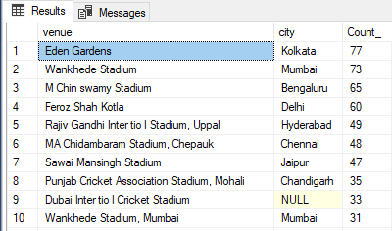
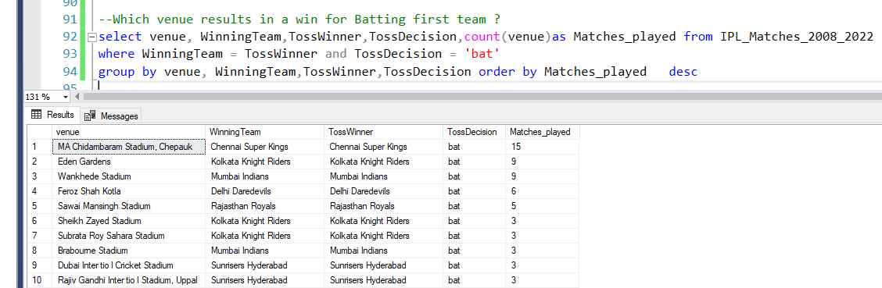
Where were the majority of matches played over the years?
Which venue results in a win for Batting first team ?

Slide 11
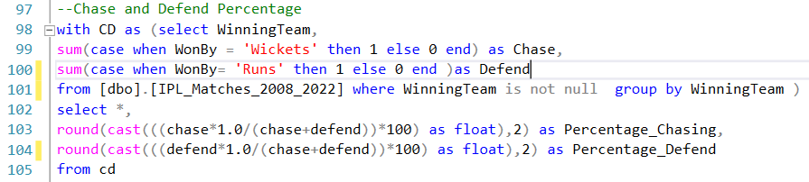
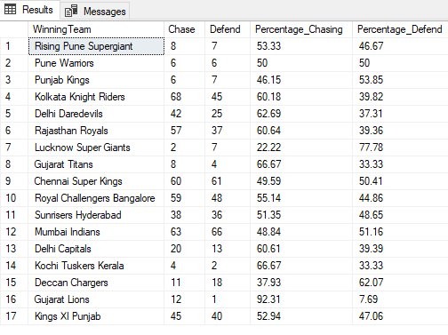
What is the Chase and Defend Percentage for Each team?

Slide 12
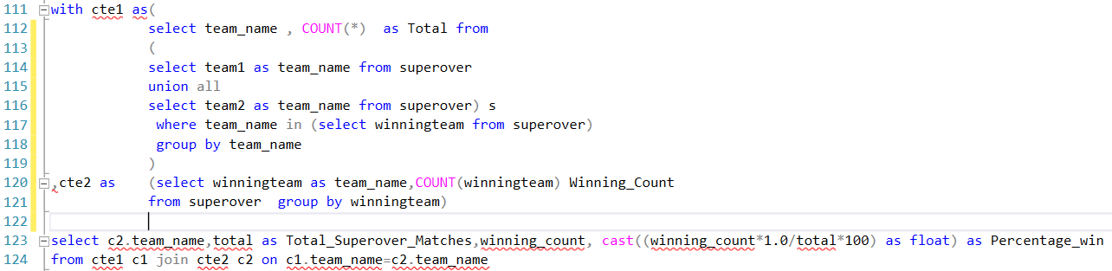
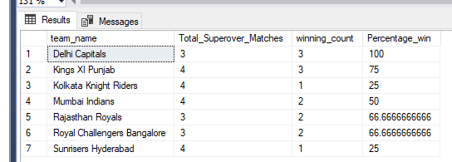
What is the percentage win in Super overs?

Slide 13
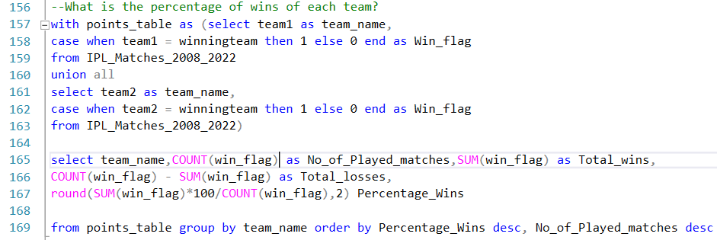
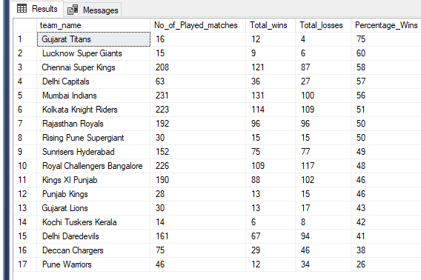
What is the overall percentage of win for each Team?

Slide 14
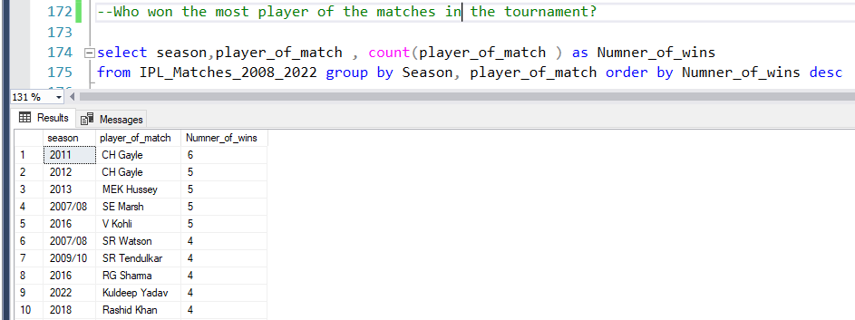
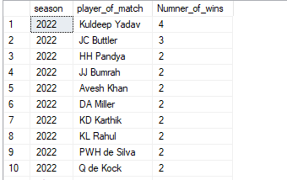
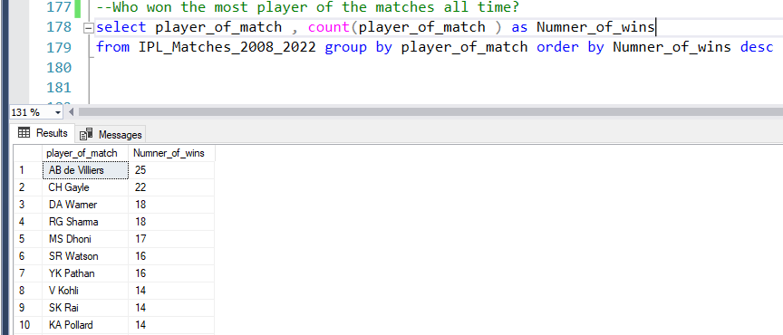
Who won the most Player of matches in respective seasons?
Who won the most Player of matches all time?

